Slide 1
Applications of Computer Vision
Instructor: Dr. Usman Ghani
Submitted to: Sir Junaid Submitted by: Hamza Farooq (Reg. 2016-CS-122)

Slide 2
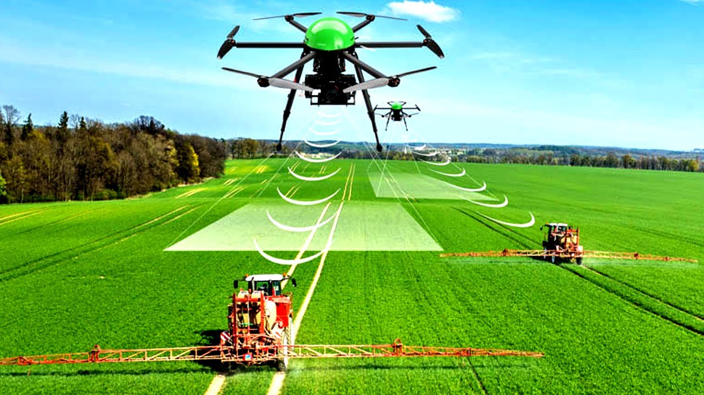
Agriculture
Agricultural drone
Smart Agri drone
Perceived area image
Controlling flow of pesticides

Slide 3
Agricultural drone Application Areas
Soil and Field Analysis
Seed Planting
Crop Spraying and Spot Spraying
Crop Mapping and Surveying
Real-Time Livestock Monitoring

Slide 4
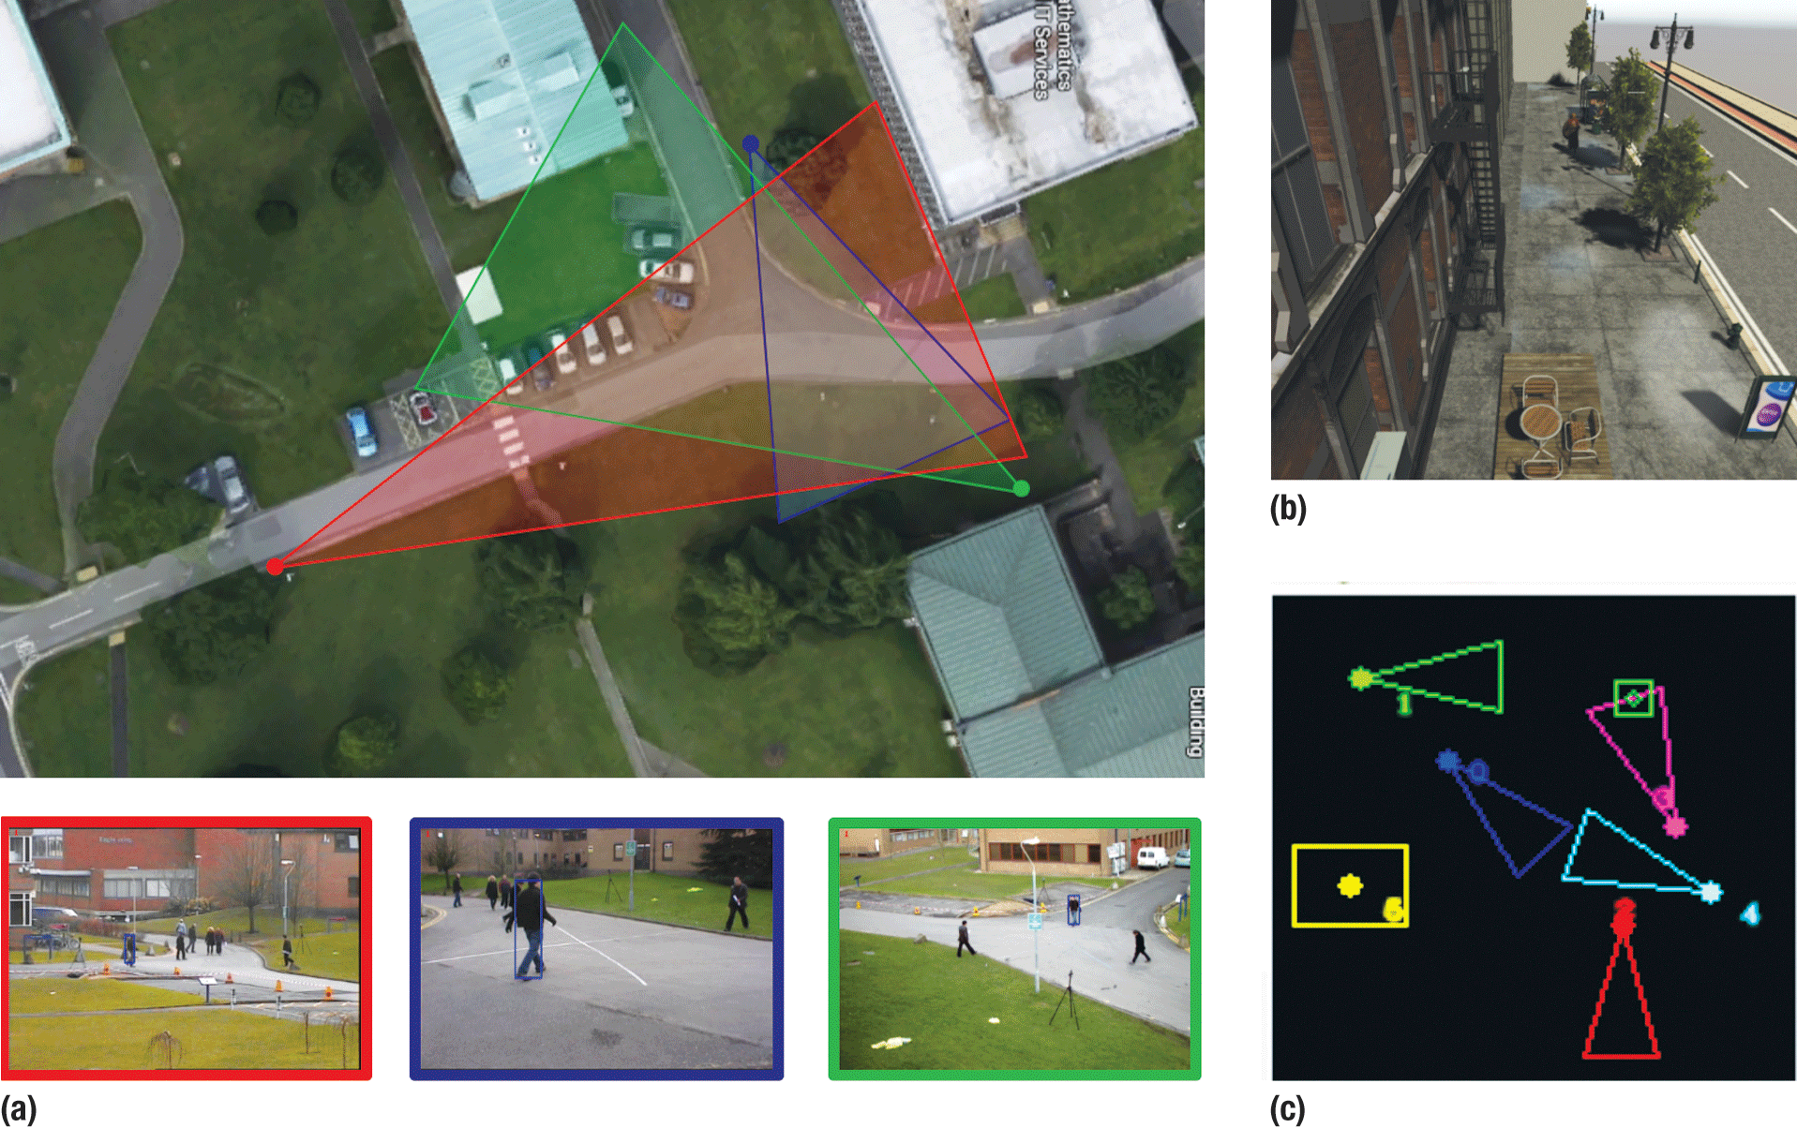
Defense
Surveillance and Security
Satellite view
Being monitored area pan
Surveillance pan

Slide 5
Defense Application Areas
Autonomous Vehicles
Landmine Removal
Quality Control for Ordnance Manufacturing
Activity Tracking
Resource Monitoring

Slide 6
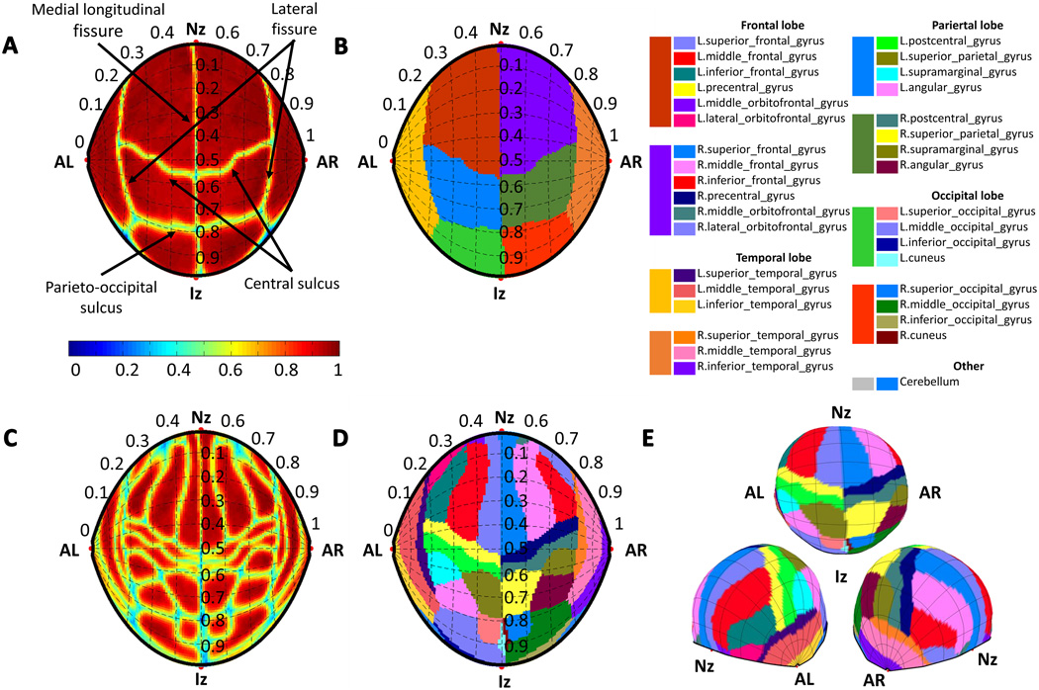
Medical
Transcranial magnetic stimulation

Slide 7
TMS Application Areas
Tumor detection and segmentation
Element level detection
Cancer classification

Slide 8
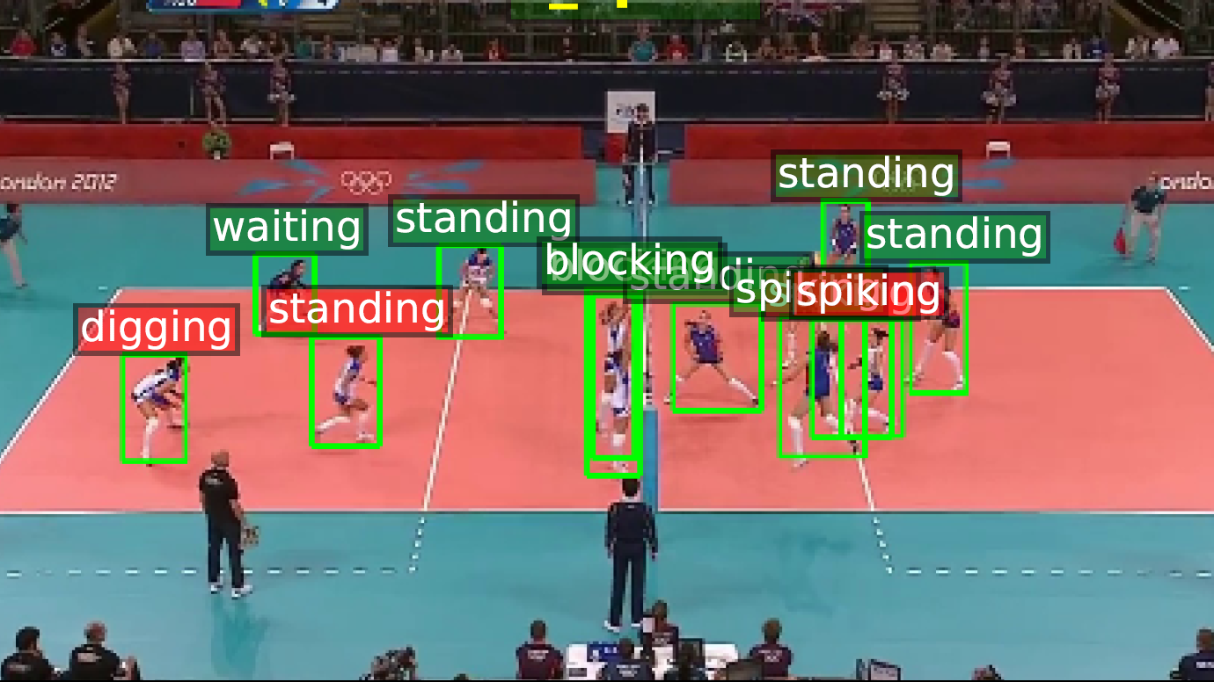
Sports
Sportsman Activity Tracker

Slide 9
SAT Application Areas
Player Tracking and Detection
Activity Classification
Player energy level approximation
Suitable environment approximation for gameplay
Decision making in critical situations

Slide 10
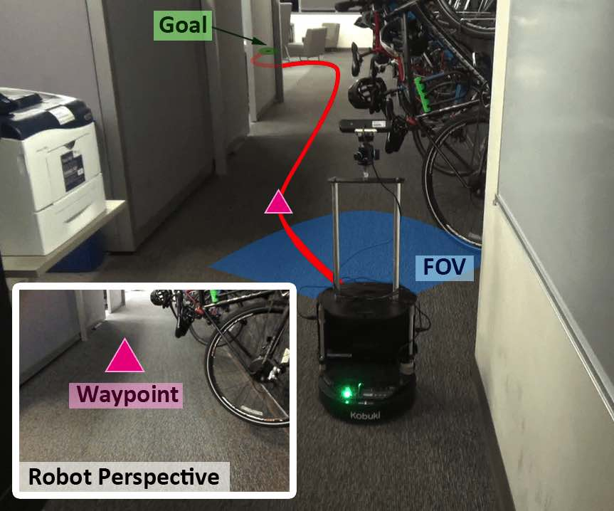
Robotics
Visual Navigation

Slide 11
Visual Navigation Application Areas
GPS smartphone applications
Unmanned Guided vehicles
Surveillance cars
Semi-Autonomous Trucks

